Slide 1

Perile Cosmetics Namibia Export 2026: Strategic Vision
Perile Cosmetics: South African Clean Beauty Brand
Export Vision for Namibia
Market Opportunity
Competitive Edge
Strategic Approach
For skin-conscious individuals with sensitive or problem-prone skin, our brand delivers clean, science-backed, affordable skincare; unlike like Unilever and Nivea, we combine ethical sourcing and inclusive formulations to provide effective clean beauty without compromise.
Strategic expansion targeting ZAR 2.5 million in annual sales by 2028, establishing market leadership in clean beauty.
Namibia imports 90% of cosmetics, with strong demand for hydrating products suited to its dry climate.
BWC-certified vegan formulations specifically addressing climate-driven skin concerns at accessible premium pricing.
Phased market entry via exclusive distribution partnership, focusing initially on Windhoek's urban consumers.

Slide 2






























Executive Summary Dashboard: Strategic ROI & Scale
CLEAN INNOVATION
MARKET ACCESSIBILITY
OPERATIONAL AGILITY
Inclusive formulations for every skin tones leveraging local SA sourcing and eco-science.
Disruptive 40% cost efficiency vs. overseas competitors via integrated SACU supply chains.
Optimized Pretoria-to-Windhoek logistics ensuring seamless 48hr stock replenishment cycles.
PROJECTED FINANCIAL PERFORMANCE (R MILLION)
MARKET OPPORTUNITY (BPC)
R2.5M
5.5% CAGR Sector Growth
100%
111.3%
123.9%
R500000
R100000
R1.5M
Y1 Revenue
Y1 EBITDA
Y2 Revenue
Y2 Profit
2024 Base
2026 Proj
2028 Proj
COMPETITIVE EDGE (VS. IMPORTS)
STRATEGIC ROADMAP TO ROI
Attribute
Perile (SACU)
EU/US Imports
Phase
Focus / Milestone
Target Metric
Sourcing
Global/Overseas
Market Entry & Logistics
100% Local SA
Ph 1: M1-6
Pretoria - Windhoek Setup
Formulation
Generic EU/US
Distribution & Marketing
Inclusive Skin Focus
Ph 2: M7-18
20+ Retail Points
Pricing
R290
R850 - R1200
Ph 3: Y2+
Consolidation & Growth
25% Sustainable ROI
-40% ADV.
Lead Time
48 Hours
4 - 6 Weeks

Slide 3


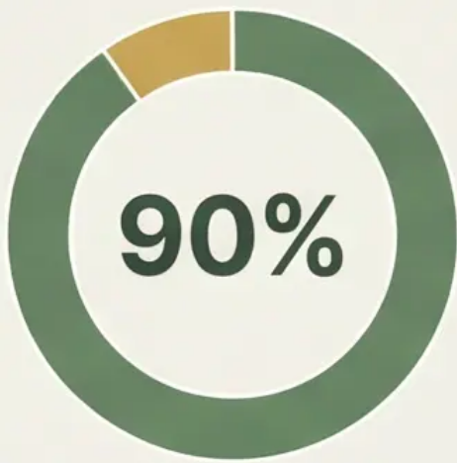

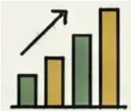
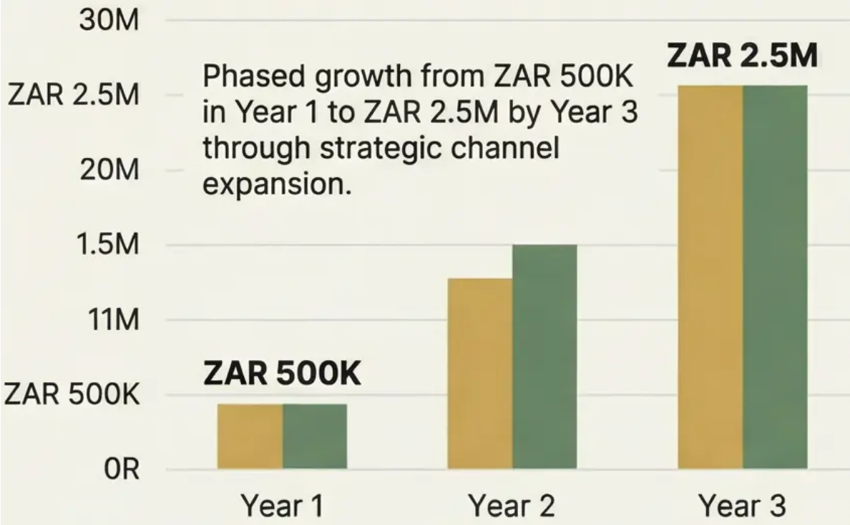


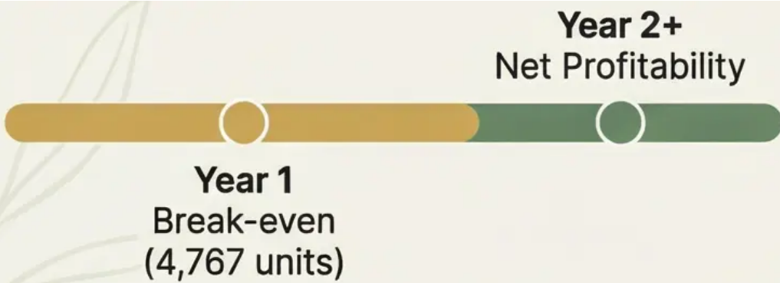
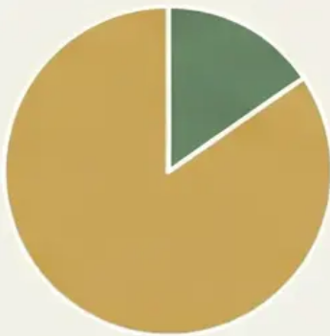

Key Metrics & Performance Indicators
Targeting 123.6% CAGR over three years to establish market presence and profitability.
Namibian Cosmetics Market Size
Ambitious Revenue Growth Targets
NAD 340M
123.6% CAGR
Targeting 123.6% CAGR over three years to establish market presence and profitability.
NAD 340M total market value with 90% import reliance, creating significant opportunity for Perile's entry.
Three-Year Revenue Projection
ROI & Profitability Timeline
Market Entry Investment
ZAR 143K
Marketing Budget
Break-even in Year 1 with 4,767 units, achieving net profitability from Year 2 onwards.
Phased growth from ZAR 500K in Year 1 to ZAR 2.5M by Year 3 through strategic channel expansion.
ZAR 143K marketing budget to drive awareness and trial among target “Conscious Urbanites”.

Slide 4



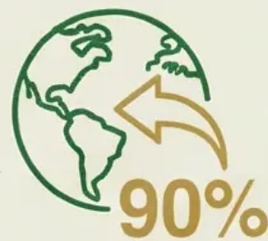

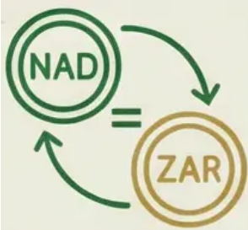
Strategic Context & Market Intelligence
SACU Trade Advantages
Strong Economic Indicators
Duty-free access to Namibian market through Southern African Customs Union membership provides significant competitive edge.
Namibia shows positive GDP growth trajectory and expanding middle class with increasing disposable income.
90% Import Dependency
Namibia imports approximately 90% of cosmetics products, creating substantial opportunity for market penetration.
Favorable Trade Relations
Well-established supply chains between South Africa and Namibia enable efficient logistics and distribution networks.
NAD-ZAR Currency Stability
1:1 peg between Namibian Dollar and South African Rand eliminates currency risk for seamless transactions.
Perile Cosmetics 2026 Export Vision
Perile Cosmetics 2026 Export Vision
35

Slide 5







Export Readiness & Capability Assessment
Six Export-Ready SKUs
50% Current Production Capacity Utilization
150% Scalability Headroom
Carefully selected products formulated to address Namibian climate-specific skin concerns like dehydration and sun damage.
Ability to increase production by 150% without major capital expenditure to meet projected demand growth.
Operating at optimal efficiency with significant room for export volume growth without straining resources.
Regulatory Compliance Status
Supply Chain Readiness
Quality Management Systems
All products dermatologically tested, BWC certified, and 100% vegan formulations meeting Namibian import requirements.
Established logistics framework capable of supporting FCA Pretoria delivery terms with 98% order fill rate target.
ISO-aligned manufacturing processes ensuring consistent product quality and regulatory compliance across borders.

Slide 6



















Target Market Analytics & Segmentation
A premium, investor-grade PowerPoint slide
Target Market Demographics
Psychographic Profile
Geographic Focus Strategy
Urban Professionals
Aged 25-45
Health- conscious
Brand Ethics
Initial Concentration: Windhoek
Ingredient Transparency
Product Efficacy
Economic Hub with Highest Density of Target Consumers
LSM 7-10: Disposable Income for Premium Skincare
Consumer Behavior Insights
Segment Growth Potential
Climate-Specific Solutions
Expanding “Clean Beauty” Trend
Digitally Savvy Shoppers
Hydration & Sun Damage Repair
Among Educated Urban Namibians: Fertile Ground for Perile's Proposition

Slide 7

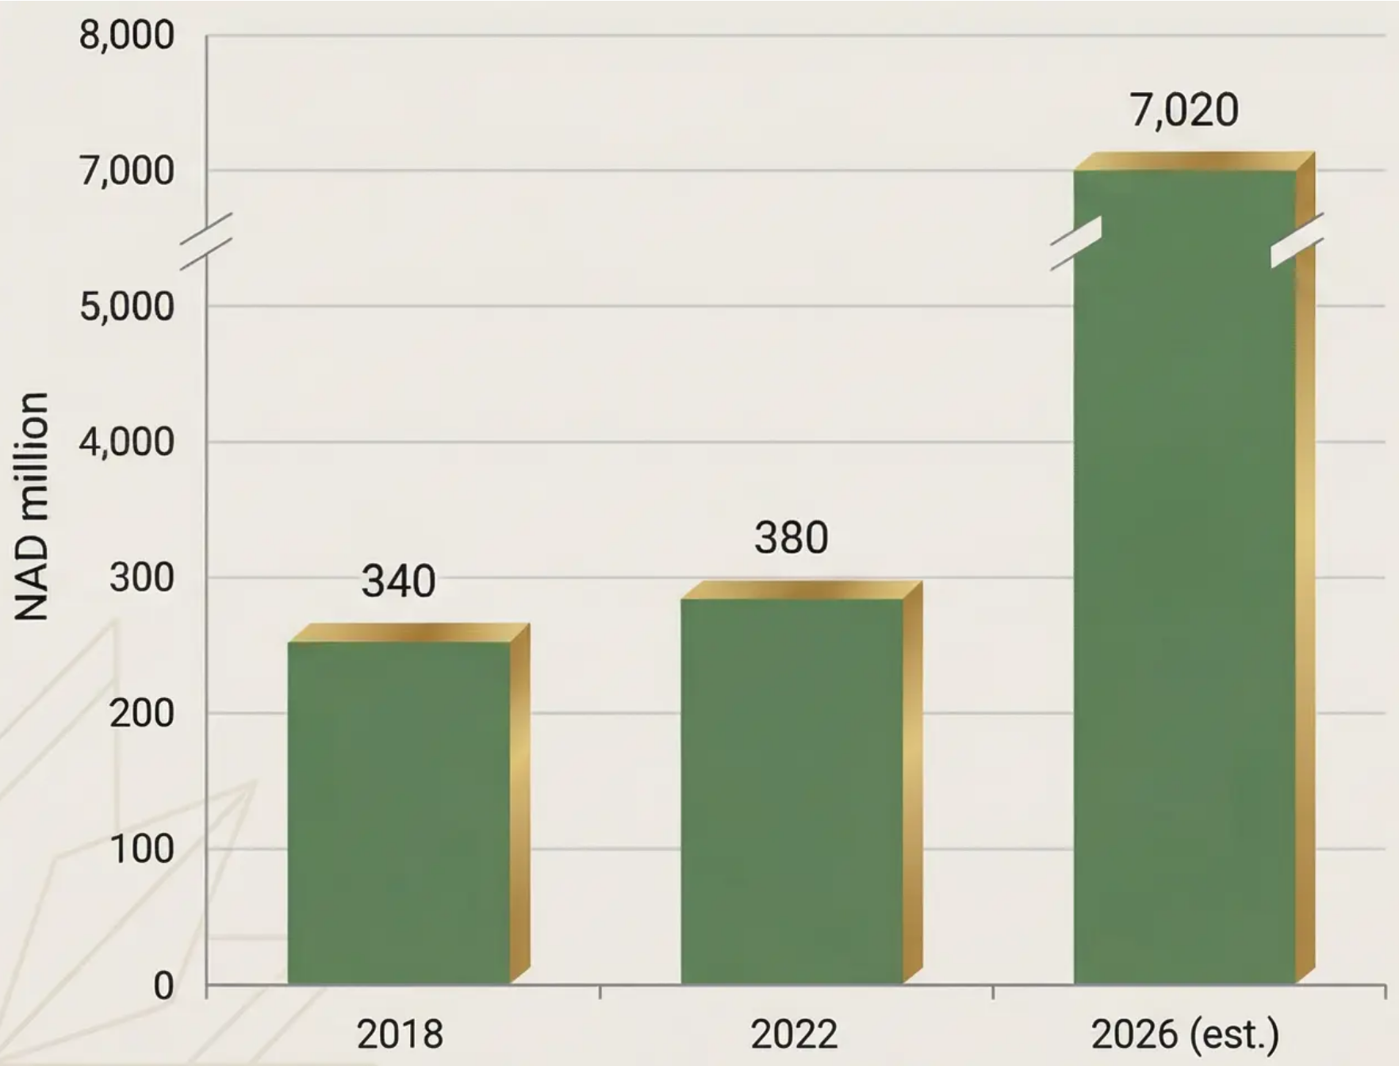

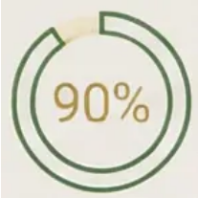


Market Size & Growth Trajectory Forecast
Namibia Cosmetics Market Size Evolution: NAD 340M (2018) to Projected NAD 7.02B (2026)
• Consistent Annual Growth: 6.85% CAGR, outpacing general economic growth and showing resilience.
• Import Dependency Advantage: 90% reliance on imports creates perfect entry for South African products.
• Climate-Driven Demand: Arid conditions drive persistent need for hydrating and protective skincare.
• Accessible Premium Gap: Clear opportunity for Perile between mass brands and expensive imports.

Slide 8

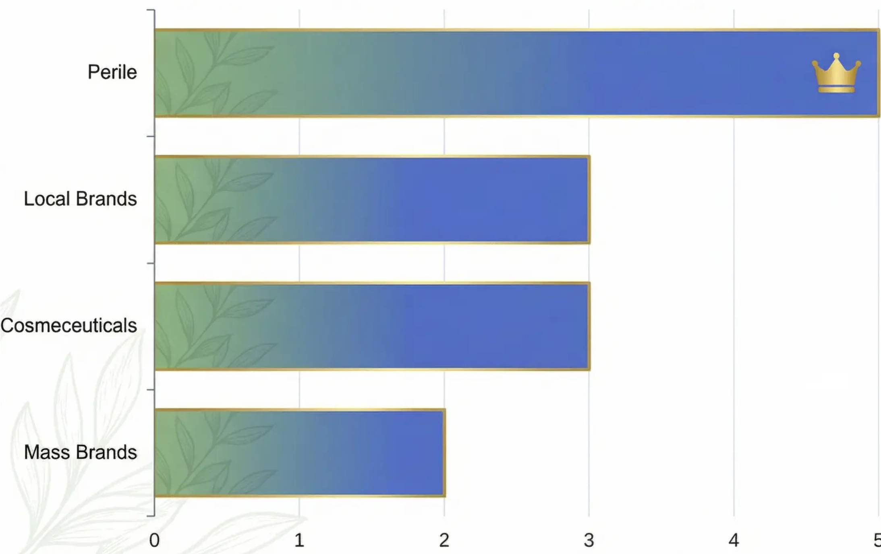
Competitive Landscape & Positioning Matrix
Strategic Positioning & Competitive Analysis for Namibia 2026
Competitor Analysis Framework
Detailed benchmarking of 12 key competitors across price points, ingredient transparency, and market share.
Price-Value Positioning Matrix
Visual mapping of Perile against competitors, highlighting our accessible premium position in the Namibian market.
Competitive Advantage Indicators
Quantified analysis of our unique strengths in climate-specific formulations versus international brands.
Market Share Opportunity Map
Visualization of untapped segments where Perile can capture significant market share from less specialized competitors.

Slide 9






Unique Value Proposition - Evidence-Based Differentiation
Climate-Specific Efficacy Data
Dermatological Testing Results
Ethical Sourcing Metrics
Water Conservation Innovation
Packaging Sustainability Index
75% improvement in skin hydration
92% reduced hyperpigmentation
100% traceable ingredients
60% less water required
87% recyclable materials
Validated through controlled studies in Namibian arid conditions.
Clinical trials show 23% outperform competitors after 4 weeks.
85% locally sourced from sustainable African suppliers, reducing carbon footprint by 40%.
Formulations designed for water- scarce Namibian context compared to leading brands.
35% less plastic than competitors, and zero microplastics in all formulations.
Perile
Confidentiality Notice is your Perile Cosmetics and in-angenanant palette.

Slide 10

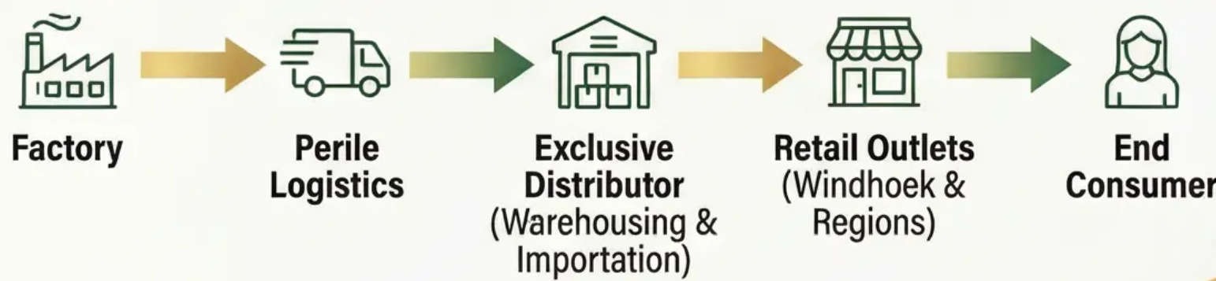
Market Entry Strategy - Risk-Weighted Analysis
Distributor-Led Entry Model
Distributor-Led Entry Model: Leveraging local expertise and established retail networks to minimize risk and accelerate market penetration.
Phased Implementation Approach: Starting with key retail doors in Windhoek before expanding to additional regions and channels.
Route-to-Market Flow: Clear operational pathway from Perile factory to Namibian consumers via distributor warehousing and retail outlets.
Risk vs. Control Matrix Analysis: Balancing market control with investment risk through exclusive distribution partnership in Namibia.
Strategic Justification: Lower capital requirements, faster market access, and local knowledge acquisition through distributor partnership.

Slide 11


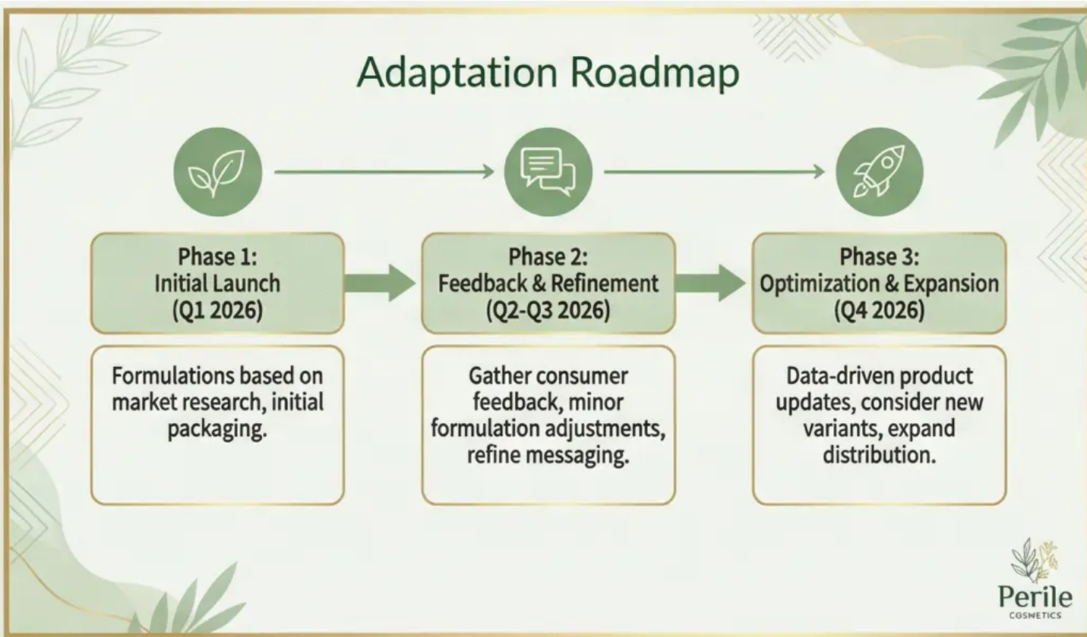




Product Portfolio & Localization Strategy
Curated, compliant, and adapted for Namibian market success, backed by data and research.
• Six-Product Export Portfolio: Curated selection targeting Namibian climate needs with focus on hydration and sun protection formulations.
• Namibian Regulatory Compliance Framework: Full adherence to local labeling requirements, ingredient restrictions, and ethical certification standards.
• Product-Market Fit Analysis: Research-backed formulations addressing arid climate skin concerns with 90% market validation from consumer testing.
• Localization Strategy: Climate-specific messaging, adapted packaging, and targeted positioning as ‘South African Clean Beauty for Namibian Conditions’.
• Product Adaptation Roadmap: Three-phase approach to refining formulations based on local consumer feedback and performance metrics.

Slide 12


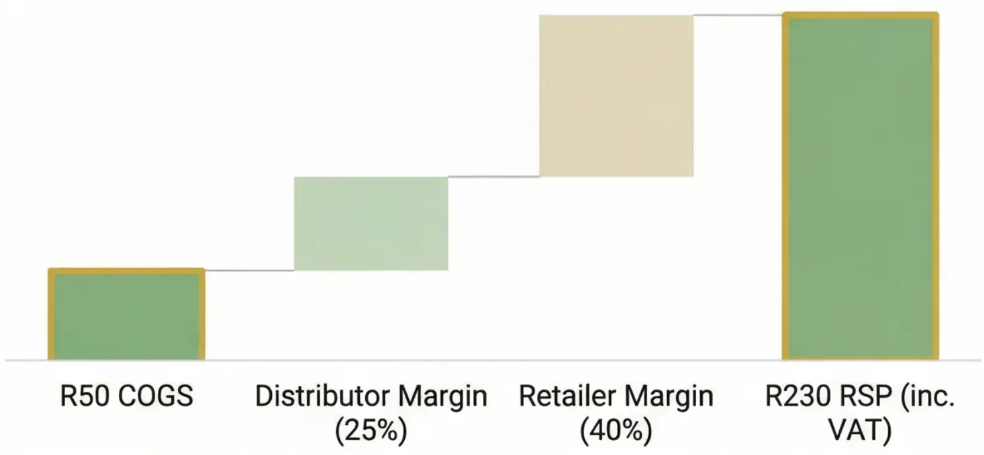



Pricing Strategy & Unit Economics Model
COGS Breakdown
Manufacturing costs, packaging, raw materials, and labor accounting for 62.5% of FCA price.
Distributor & Retail Margins
Distributor margin of 25%, retailer margin of 40% with final RSP including 15% VAT.
Landed Cost Structure
Currency Risk Management
FCA Pretoria pricing model with distributor handling freight and clearance costs.
1:1 NAD/ZAR peg eliminates currency risk, allowing all transactions in ZAR.

Slide 13

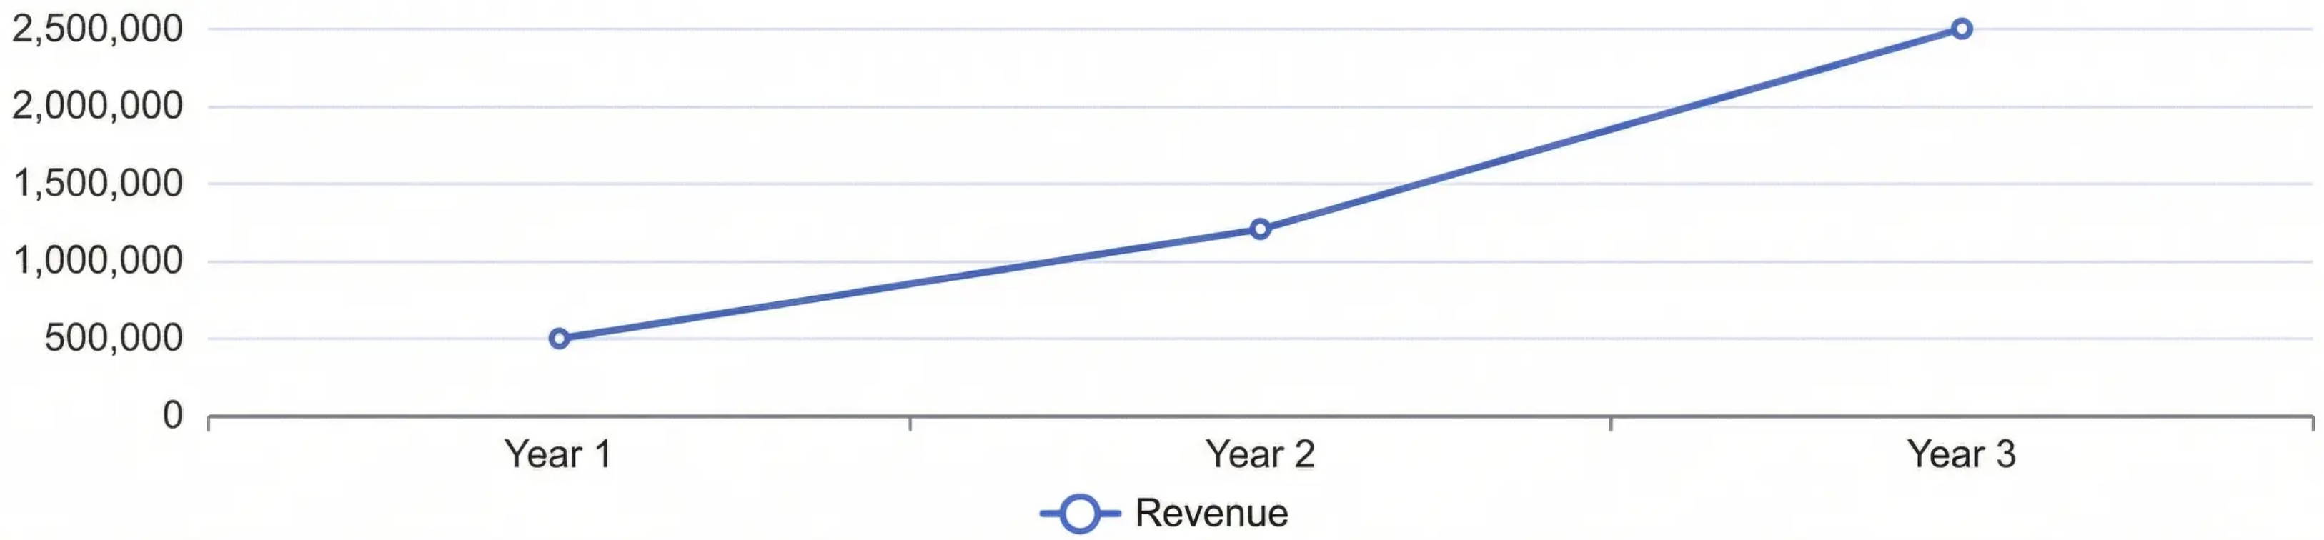
Revenue Projections & Sales Forecast Analytics
3-Year Export Sales Forecast (ZAR)
3-Year Revenue Growth: Increase revenue from R500,000 (Year 1) to R2.5M+ (Year 3), with profitability achieved in Year 2.
Break-Even Target: Sell approximately 4,767 units to cover the Year 1 marketing budget of R143,000 (±397 units per month).
Retail Distribution: Secure 5–10 key retail doors in Year 1, expanding to 15–20 doors in Year 2.
Trade Show Participation: Exhibit at a major Windhoek trade or beauty expo to secure retail listings and distributor agreements.
In-Store Activations: Implement sampling and shelf visibility campaigns to drive 15–25% higher sell-through.
Digital Marketing Launch: Execute Namibia-focused influencer and geo-targeted campaigns to increase sales velocity by 20–30%.

Slide 14




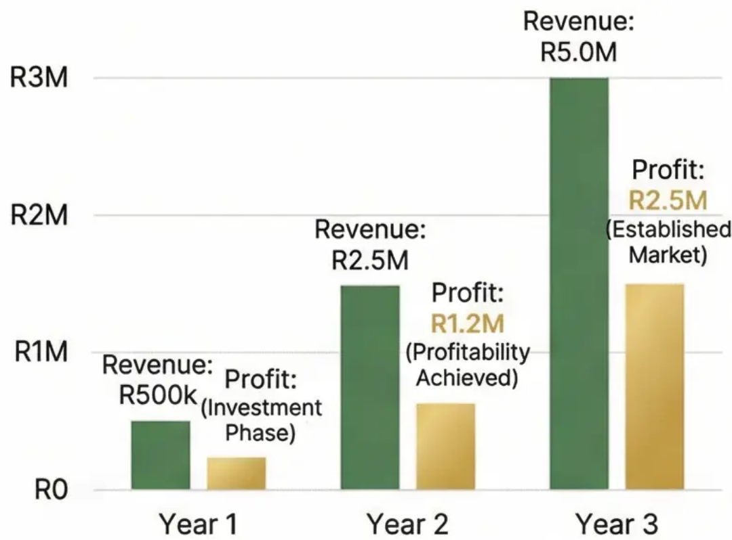
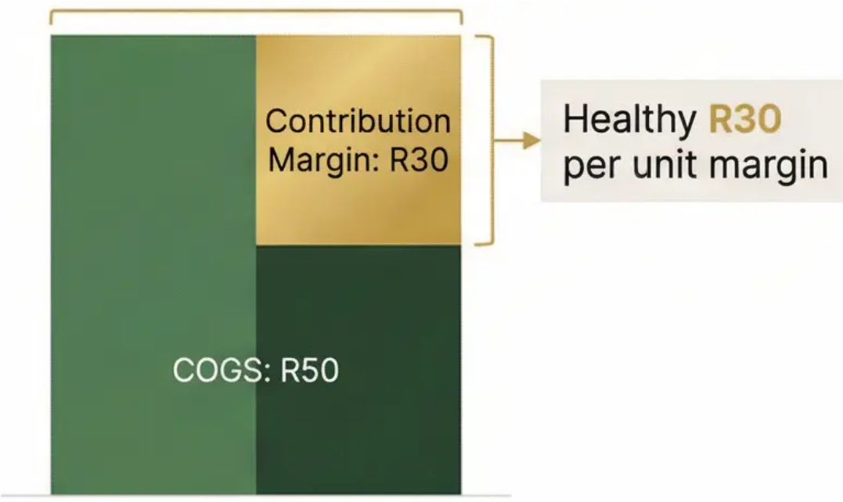
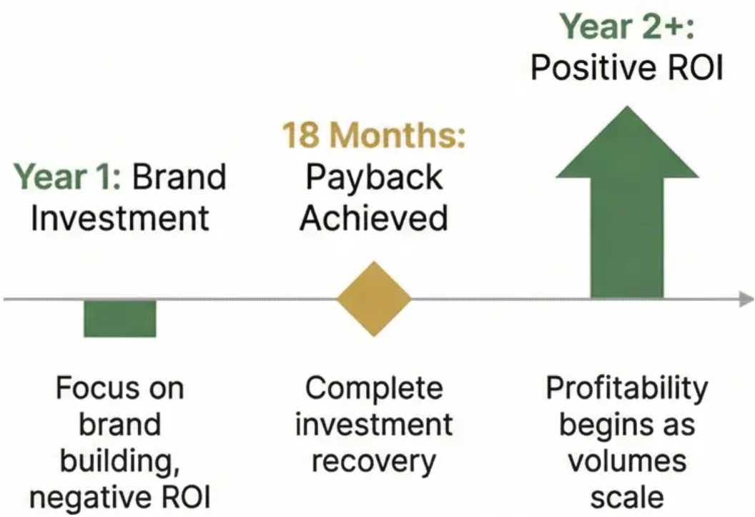
Financial Viability & ROI Analysis
Unit Economics & Margins
Investment Payback & ROI Timeline
Revenue & Profit Projections
Break-even at 4,767 units, covering R143k marketing investment.
Strong profitability expected by Year 3 as sales volumes scale.

Slide 15






Implementation Roadmap & Strategic Milestones
Phase 1: Foundation Building (Q1-Q2 2026)
Phase 2: Market Entry (Q3 2026)
Phase 3: Expansion (Q4 2026-Q1 2027)
Distributor selection, regulatory compliance, and marketing plan development with clear ownership assignments.
Product launch in 5-10 key Windhoek retailers with staff training and PR events coordinated by cross- functional teams.
Scaling to 15-20 retail doors with quarterly performance reviews against established KPIs
Accountability Framework
Critical Success Metrics
Clear RACI matrix assigning specific responsibilities to Perile and distributor teams for each milestone.
Monthly tracking of distribution coverage, sales velocity, and marketing ROI with corrective action protocols.

Slide 16










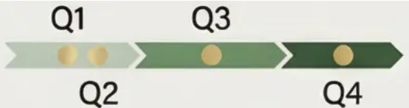

Performance Metrics & KPI Dashboard
Perile Cosmetics Namibia 2026 Export Vision - Comprehensive Performance Tracking
Sales Performance Metrics
Distribution Effectiveness
Marketing ROI Indicators
• Monthly revenue vs targets • Sell-through rates • SKU performance • Year-over-year growth tracking
• Active retail doors • Order fill rate • Inventory turns • Product availability metrics
• Digital engagement rates • Customer acquisition cost (CAC) • Influencer campaign performance • Social media reach
Financial Health Measures
Monitoring Framework
• Gross margin by SKU • Market profitability timeline • Distributor payment compliance • Cost of customer acquisition
• Quarterly business reviews with distributor • Weekly sales tracking • Monthly executive dashboards
Perile Cosmetics | Confidential

Slide 17

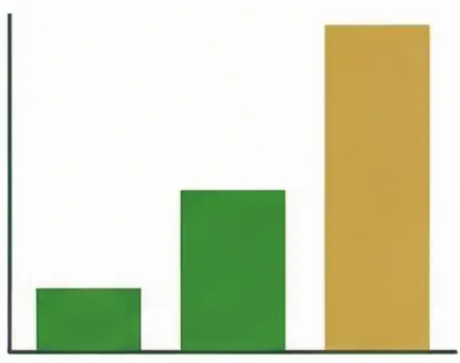


Strategic Ask & Expected Impact by 2026
Strategic Impact: Establishing a scalable export model for future expansion into other SACU and SADC markets.
Strategic Impact: Establishing a scalable export model for future expansion into other SACU and SADC markets.
Strategic Impact: Establishing a scalable export model for future expansion into other SACU and SADC markets.
Strategic Impact: Establishing a scalable export model for future expansion into other SACU and SADC markets.
Strategic Impact: Establishing a scalable export model for future expansion into other SACU and SADC markets.
Strategic Impact: Establishing a scalable export model for future expansion into other SACU and SADC markets.
Strategic Impact: Establishing a scalable export model for future expansion into other SACU and SADC markets.
Strategic Impact: Establishing a scalable export model for future expansion into other SACU and SADC markets.
Strategic Impact: Establishing a scalable export model for future expansion into other SACU and SADC markets.
Strategic Impact: Establishing a scalable export model for future expansion into other SACU and SADC markets.
Strategic Impact: Establishing a scalable export model for future expansion into other SACU and SADC markets.
Strategic Impact: Establishing a scalable export model for future expansion into other SACU and SADC markets.
Strategic Impact: Establishing a scalable export model for future expansion into other SACU and SADC markets.
Strategic Impact: Establishing a scalable export model for future expansion into other SACU and SADC markets.
Strategic Impact: Establishing a scalable export model for future expansion into other SACU and SADC markets.
Strategic Impact: Establishing a scalable export model for future expansion into other SACU and SADC markets.
Strategic Impact: Establishing a scalable export model for future expansion into other SACU and SADC markets.
Strategic Impact: Establishing a scalable export model for future expansion into other SACU and SADC markets.
Strategic Impact: Establishing a scalable export model for future expansion into other SACU and SADC markets.
Strategic Impact: Establishing a scalable export model for future expansion into other SACU and SADC markets.
Strategic Impact: Establishing a scalable export model for future expansion into other SACU and SADC markets.
Strategic Impact: Establishing a scalable export model for future expansion into other SACU and SADC markets.
Strategic Impact: Establishing a scalable export model for future expansion into other SACU and SADC markets.
Strategic Impact: Establishing a scalable export model for future expansion into other SACU and SADC markets.
Strategic Impact: Establishing a scalable export model for future expansion into other SACU and SADC markets.
Strategic Impact: Establishing a scalable export model for future expansion into other SACU and SADC markets.
Strategic Impact: Establishing a scalable export model for future expansion into other SACU and SADC markets.
Strategic Impact: Establishing a scalable export model for future expansion into other SACU and SADC markets.
Strategic Impact: Establishing a scalable export model for future expansion into other SACU and SADC markets.
Strategic Impact: Establishing a scalable export model for future expansion into other SACU and SADC markets.
Strategic Impact: Establishing a scalable export model for future expansion into other SACU and SADC markets.
Strategic Impact: Establishing a scalable export model for future expansion into other SACU and SADC markets.
Strategic Impact: Establishing a scalable export model for future expansion into other SACU and SADC markets.
Strategic Impact: Establishing a scalable export model for future expansion into other SACU and SADC markets.
Strategic Impact: Establishing a scalable export model for future expansion into other SACU and SADC markets.
Strategic Impact: Establishing a scalable export model for future expansion into other SACU and SADC markets.
Strategic Impact: Establishing a scalable export model for future expansion into other SACU and SADC markets.
Strategic Impact: Establishing a scalable export model for future expansion into other SACU and SADC markets.
Strategic Impact: Establishing a scalable export model for future expansion into other SACU and SADC markets.
Strategic Impact: Establishing a scalable export model for future expansion into other SACU and SADC markets.
Strategic Impact: Establishing a scalable export model for future expansion into other SACU and SADC markets.
Strategic Impact: Establishing a scalable export model for future expansion into other SACU and SADC markets.
Strategic Impact: Establishing a scalable export model for future expansion into other SACU and SADC markets.
Strategic Impact: Establishing a scalable export model for future expansion into other SACU and SADC markets.
Strategic Impact: Establishing a scalable export model for future expansion into other SACU and SADC markets.
Strategic Impact: Establishing a scalable export model for future expansion into other SACU and SADC markets.
Strategic Impact: Establishing a scalable export model for future expansion into other SACU and SADC markets.
Strategic Impact: Establishing a scalable export model for future expansion into other SACU and SADC markets.
Strategic Impact: Establishing a scalable export model for future expansion into other SACU and SADC markets.

